Slide 1

Translated from Japanese to English - www.onlinedoctranslator.com
site map
smartphone
top page
Studio introduction
Studio details
Notification display ( 3(Break)
Shinsaibashi Amemura store
Live hall
Plan introduction
Usage flow and charges
Usage fee
Use case
I recommend this hotel!
Traffic access
reservation
Studio selection → Reserve → Prepaid
Free information calendar
Schedule time selection
Plan selection
Confirmation tentative reservation
Static page
System update
Mail form
Terms of Service
External link
FAQ
Inquiries
privacy policy

Slide 2
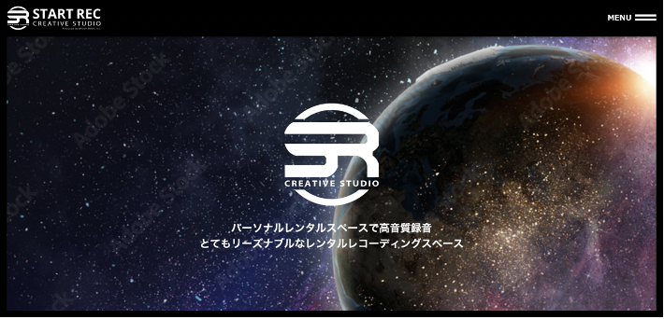
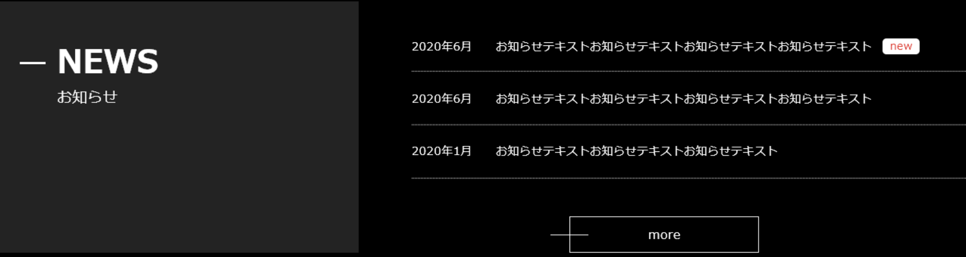
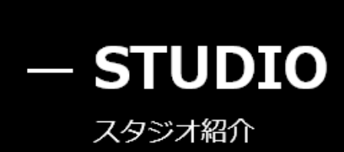
top page
← Notification display
← Other posted notices are displayed
(CSSProcess with)
← Static display
>> More
The next page is also statically displayed
- PLANIntroduction
← Static display
・
・
・

Slide 3
Reserve
This image is a wire (framework).
As soon as the content is decided, the designer will recreate the design.
smartphone
After clicking the reservation button, be sure to move to this screen
If you are not logged in
Studio reservation
STEP display
■ Fill in the required information
For online reservations
Membership registration required
Click here for first-time users
New member registration
No need for troublesome input from the next time!
ID:
password:
*If you have forgotten your passwordHere
Login

Slide 4
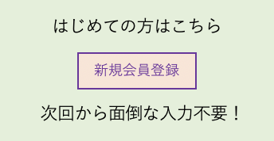
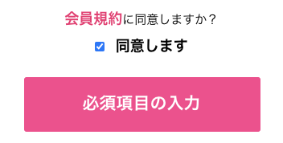
Reserve
This image is a wire (framework).
As soon as the content is decided, the designer will recreate the design.
smartphone
If you are not logged in
<New registration>
Studio reservation
Membership agreement
Contains the membership agreement text

Slide 5
Reserve
This image is a wire (framework).
As soon as the content is decided, the designer will recreate the design.
smartphone
Studio reservation
STEP display
■ Enter your email address
email address
Send registration email
Registration Form https: // URL
■ Registration
For registration to the email address you enteredURLAn email was sent with the information.
Described in the emailURLPlease move to the registration page, fill in the necessary information, and press the registration button.
If you do not see the auto-reply email in your normal inbox, please check your email folder as it may be received in your email folder.
TOPBack to

Slide 6
Reserve
This image is a wire (framework).
As soon as the content is decided, the designer will recreate the design.
smartphone
If you are not logged in
<New registration>
Studio reservation
STEP display
■ Please fill in the required information
◯ Individual ● Corporation
Name (corporate name)
Furigana
Name of person in charge
Postal code
prefectures
address
Building name
telephone number
Other contact information
email address
aaaa@xxx.cc
password
I used all half-width numbers and letters8Please enter a password with more than one digit.
Password confirmation
□privacy policyI agree with
Registration application

Slide 7
Reserve
This image is a wire (framework).
As soon as the content is decided, the designer will recreate the design.
smartphone
If you are not logged in
<New registration>
Studio reservation
STEP display
■ Please fill in the required information
Name (corporate name)
IMG Flow Co., Ltd.
Furigana
Yugen Gaisha Aimuji Furo
Name of person in charge
Kentaro Doi
Postal code
550-0004
prefectures
Osaka
address
Utsubohonmachi, Nishi-ku, Osaka2-6-13
Building name
HommachiSE2nd floor of the building
contact address
06-4400-8329
Other contact information
090-9217-0288
email address
doiken@img-flow.com
□ There is no mistake in the above contents.
register

Slide 8

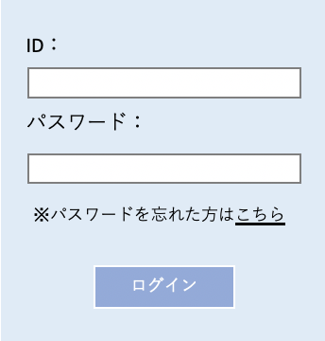
Reserve
This image is a wire (framework).
As soon as the content is decided, the designer will recreate the design.
smartphone
If you are not logged in
<New registration>
Studio reservation
■ Thank you for registering.
We have sent you a registration confirmation email
please confirm.
Text dummy Text dummy
Return to login screen
■ Thank you for registering.

Slide 9
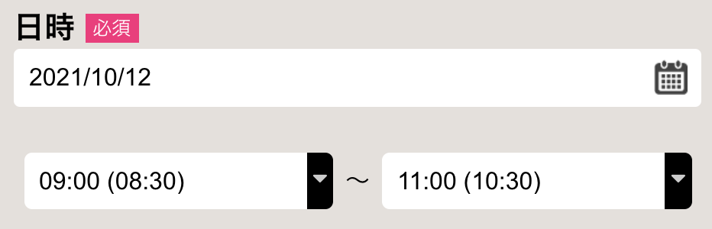



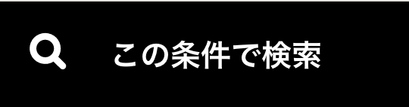
Reserve
This image is a wire (framework).
As soon as the content is decided, the designer will recreate the design.
smartphone
Choose from date and time
Choose from stores
*Since there is only one store, comment out once
Studio reservation
STEP display
Selected for only one store
Shinsaibashi Amemura store
◆ Expert options
□ Cameraman
□ Recording engineer
□ Director / Director
◆ Equipment equipment set
□Yogibo
□ Headset
◆ Editing set
□ Editing for music videos
□YoutubeProgram editing
*Show options

Slide 10
Reserve
This image is a wire (framework).
As soon as the content is decided, the designer will recreate the design.
smartphone
Studio reservation
STEP display
Store selection
A
re-search
Shinsaibashi Amemura store
Plan details
space:Live Hall <Details>
Chroma key shooting plan
1 hour:1,000circle
2021YearTenMonth12Day
9:00 ~ 11:00
A
price:3,000circle
Area / features
If you are logged out
Transition to login screen
SET
Chroma key
Proof
camera
Reserve
・
・

Slide 11

Reserve
This image is a wire (framework).
As soon as the content is decided, the designer will recreate the design.
smartphone
Studio reservation
STEP display
■ Reservation details
Your reservation is not complete yet!
Osaka Shinsaibashi Amemura store
Live hall
Chroma key shooting plan
SET
A
Chroma key
Proof
camera
2021YearTenMonth12Day
IN→ 14:00
OUT→ 17:00
Option selection
price
3,000circle
(tax included3,300circle)
◆ Usage details / requests
---- Please select ----
Applications other than the above
If you have any details or requests, please write them down.
◆ Additional options
◆ Expert options
□ Cameraman
・
・
・
□ Director / Director
□ Recording engineer
◆ Equipment equipment set
Additional options
□Yogibo
□ Headset
◆ Editing set
□ Editing for music videos
□YoutubeProgram editing
Verification
<< Back

Slide 12
Reserve
This image is a wire (framework).
As soon as the content is decided, the designer will recreate the design.
smartphone
Studio reservation
STEP display
■ Reservation confirmation
Your reservation is not complete yet!
Osaka Shinsaibashi Amemura store
Live hall
Chroma key shooting plan
SET
A
Chroma key
Proof
camera
2021YearTenMonth12Day
IN→ 14:00
OUT→ 16:45
price
3,000circle
<Addition>
equipmentA
additional fee:2,000circle
Total charge
5,000circle
(tax included5,500circle)
◆ Usage details / requests
YoutubeVideo shooting for
Since some chroma key shooting is done, only the western side
I want you to put a green bag in it.
Please check if there is any problem with the above contents
Reserve
<< Back

Slide 13
Reserve
This image is a wire (framework).
As soon as the content is decided, the designer will recreate the design.
smartphone
Studio reservation
■ Thank you for your reservation.
We are waiting for you on the day.
Please see here for the flow when you come to the store.
Reservation number:45847871
Osaka Shinsaibashi Amemura store
Live hall
Chroma key shooting plan
SET
A
Chroma key
Proof
camera
2021YearTenMonth12Day
IN→ 14:00
OUT→ 16:45
price
3,000circle
<Addition>
equipmentA
additional fee:2,000circle
Total charge
5,000circle
(tax included5,500circle)
◆ Usage details / requests
YoutubeVideo shooting for
Since some chroma key shooting is done, only the western side
I want you to put a green bag in it.

Slide 14
My page
This image is a wire (framework).
As soon as the content is decided, the designer will recreate the design.
smartphone
My page
◆ Account information
change
← Go to change screen
customerNo.
1234567
Name (corporate name)
IMG Flow Co., Ltd.
Furigana
Yugen Gaisha Aimuji Furo
Name of person in charge
Kentaro Doi
Postal code
550-0004
prefectures
Osaka
address
Utsubohonmachi, Nishi-ku, Osaka2-6-13
Building name
HommachiSE2nd floor of the building
contact address
06-4400-8329
Other contact information
090-9217-0288
email address
doiken@img-flow.com
password
●●●●●
◆ Acquisition points
20 POINT
◆ Reservation history
ReserveNo | Reservation store | Reservation space | Reservation plan | Reservation date | Reservation time | price
1234567 | Store nameA | hole | A | 2021/10/1 | 10:00 – 13:00 | 5,500circle
 | Store nameB | studioA |  |  |  | 6600circle
 | Store nameB | studio B |  |  |  | 11000circle

Slide 15
My page
This image is a wire (framework).
As soon as the content is decided, the designer will recreate the design.
smartphone
My page
◆ Account information
customerNo.
1234567
Name (corporate name)
IMG Flow Co., Ltd.
Furigana
Yugen Gaisha Aimuji Furo
Name of person in charge
Kentaro Doi
Postal code
550-0004
prefectures
Osaka
address
Utsubohonmachi, Nishi-ku, Osaka2-6-13
Building name
HommachiSE2nd floor of the building
contact address
06-4400-8329
Other contact information
090-9217-0288
email address
doiken@img-flow.com
password
●●●●●●●
Password confirmation
●●●●●●●
change

Slide 16
My page
This image is a wire (framework).
As soon as the content is decided, the designer will recreate the design.
smartphone
My page
◆ Account information
customerNo.
1234567
Name (corporate name)
IMG Flow Co., Ltd.
Furigana
Yugen Gaisha Aimuji Furo
Name of person in charge
Kentaro Doi
Postal code
550-0004
prefectures
Osaka
address
Utsubohonmachi, Nishi-ku, Osaka2-6-13
Building name
HommachiSE2nd floor of the building
contact address
06-4400-8329
Other contact information
090-9217-0288
email address
doiken@img-flow.com
password
●●●●●
The changes have been reflected
My pageTOPBack to

Slide 17
Studio details
This image is a wire (framework).
As soon as the content is decided, the designer will recreate the design.
smartphone
Studio details
Space name
P
Live hall Dummy text Dummy text Dummy text Dummy text
Breadth about 60㎡
The floor plan image is <here>
Perfect for small live events.
Equipment Equipment(Please request if necessary)
AAAA,BBBB,CCCC,
Please check the details of the equipment from each plan.
Store name
P
Description Comment Comment Comment Comment Comment Comment
Comment Comment Comment
Comment Comment Comment
Comment Comment Comment
Photo comment comment comment comment
P
P
P
Address Address Address Address Address Address
Address Address Address Address
MAP
Phone number: 00000000
Email address: 000000
Return to the previous screen

Slide 18
Plan details
This image is a wire (framework).
As soon as the content is decided, the designer will recreate the design.
smartphone
Plan details
Plan name
Plan description, dummy text dummy text dummy text dummy text dummy text dummy text dummy text dummy text
P
Photo Comments Comments Comments Comments Comments Comments Comments Comments
Set option
Set option
Chroma key
Proof
camera
Option list
Return to the previous screen

Slide 19
Option list
This image is a wire (framework).
As soon as the content is decided, the designer will recreate the design.
smartphone
Option list
Option category name ｜ Option category name ｜ Option category name ｜
← Anchor link
icon
Option category name
icon
Option name
P
Description Comment Comment Comment Comment Comment Comment Comment Comment Comment Comment Comment Comment
referenceURL
1 hour: 000 yen
1Day: 0000 yen
icon
Option name
P
Description Comment Comment Comment Comment Comment Comment Comment Comment Comment Comment Comment Comment
referenceURL
1 hour: 000 yen
1Day: 0000 yen
icon
Option category name
icon
Option name
P
Description Comment Comment Comment Comment Comment Comment Comment Comment Comment Comment Comment Comment
referenceURL
1 hour: 000 yen
1Day: 0000 yen
・
・

Slide 20


Reserve
This image is a wire (framework).
As soon as the content is decided, the designer will recreate the design.
smartphone
Choose from date and time
Choose from stores
Studio reservation
If you are logged in
STEP display
■ Reservation store
to the next
A
Osaka
Shinsaibashi Amemura store
A word feature display
Details Fine
B
Fukuoka
Tenjin ◯◯ store
If there is only one store
Selected state
Details Fine
A word feature display
C
Nagoya
Sakae ◯◯ store
C
A word feature display
Details Fine
to the next

Slide 21
Reserve
This image is a wire (framework).
As soon as the content is decided, the designer will recreate the design.
smartphone
Studio reservation
STEP display
Osaka Shinsaibashi Amemura store
■ Space selection
to the next
Live space
If there is only one space
Selected state
A
Ideal for ◯◯◯
Text Description Text Description Text Description Text Description
Details Fine
to the next

Slide 22
Reserve
This image is a wire (framework).
As soon as the content is decided, the designer will recreate the design.
smartphone
If there is only one store
Selected state
Studio reservation
STEP display
Osaka Shinsaibashi Amemura store
Live hall
■ Use plan selection
to the next
Live shooting plan
plan
Text Description Text Description Text Description Text Description
1 hour:1,000circle
Details Fine
Chroma key shooting plan
plan
Text Description Text Description Text Description Text Description
1 hour:1,000circle
Details Fine
Live distribution (recording) program plan
plan
Text Description Text Description Text Description Text Description
1 hour:1,000circle
Details Fine
Audience mobilizationHPLive plan
plan
Text Description Text Description Text Description Text Description
1 hour:1,000circle
Details Fine
Seminar mobilization plan
plan
Text Description Text Description Text Description Text Description
1 hour:1,000circle
Details Fine
to the next

Slide 23
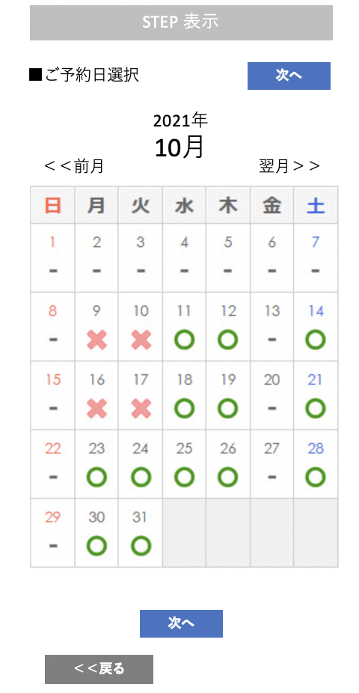
Reserve
This image is a wire (framework).
As soon as the content is decided, the designer will recreate the design.
smartphone
Studio reservation
STEP display
Osaka Shinsaibashi Amemura store
Live hall
Chroma key shooting plan

Slide 24
Reserve
This image is a wire (framework).
As soon as the content is decided, the designer will recreate the design.
smartphone
Studio reservation
STEP display
Osaka Shinsaibashi Amemura store
Live hall
Chroma key shooting plan
■ Reservation time selection
to the next
×
◯
choosing
2021YearTenMonth12Day
9:00 ~ 10:00
Book hourly
10:00 ~ 11:00
11: 00-12: 00
Extension is30Accept on-site in minutes
12: 00-13: 00
Cleaning time is continuous
Only when a reservation application is made
Adjust by telephone etc.
13: 00-14: 00
14: 00-15: 00
15:00 ~ 16:00
16: 00-17: 00
・
・
・
◆ Expert options
□ Cameraman
□ Recording engineer
□ Director / Director
◆ Equipment equipment set
Option selection
□Yogibo
□ Headset
◆ Editing set
□ Editing for music videos
□YoutubeProgram editing
To reservation confirmation screen
<< Back

